Slide 1
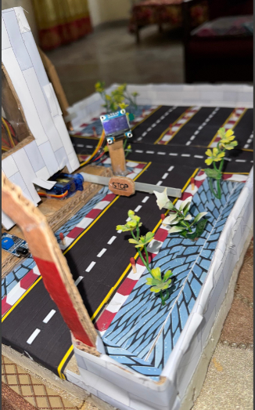
Smart Car Parking System
Presented by:
Uzair Asif
Ammar Yasir
Ibrahim Zafar

Slide 2
Introduction
A smart car parking system is a modern way to manage parking spaces using sensors and automated controls. It tracks vehicles entering and exiting to update available slots in real time. The system provides clear information on displays, making parking easier and more organized. With automated gates and efficient monitoring, the system reduces manual effort and streamlines parking operations, making it ideal for modern parking facilities.

Slide 3
Components:
1 Arduino Uno
Mini Breadboard
2 IR Sensors (for entry and exit)
2 Servo Motors (for entry and exit)
1 OLED

Slide 4
Working
The smart parking system uses IR sensors to detect vehicles entering or exiting the parking lot. When a vehicle approaches the entry sensor, the system checks if slots are available. If slots are free, the entry gate opens, allowing the vehicle to enter, and the available slot count decreases. For exiting vehicles, the exit sensor triggers the exit gate to open, and the available slot count increases. An OLED display shows real-time updates on the number of available slots or displays "Parking Full" if no slots are free. The system automates parking management efficiently.

Slide 5
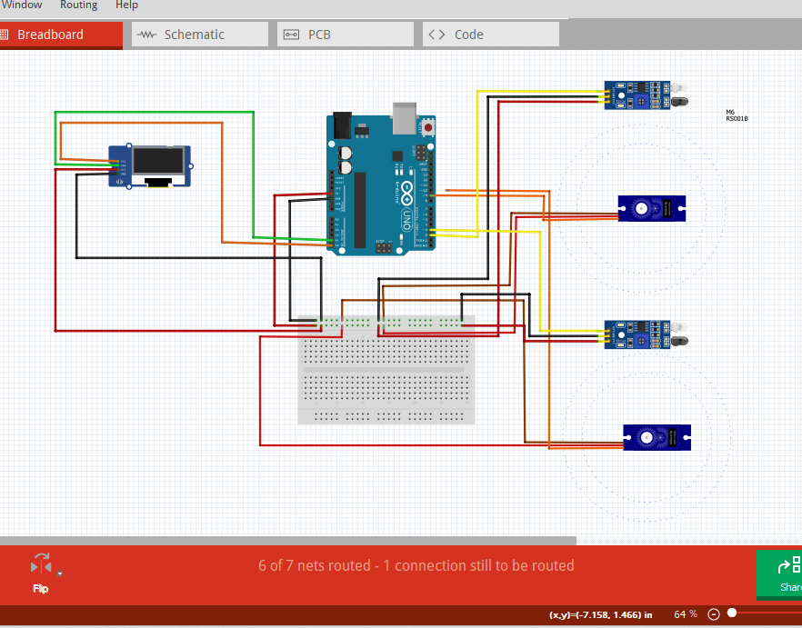
PIN Diagram

Slide 6
Scope:
Automatic Parking Management: It tracks available parking spaces automatically, reducing manual work.
Real-time Updates: The system shows parking availability on an OLED display for user convenience.
Expandable: It can be scaled to manage larger parking areas with more sensors.
Reduced Traffic: It helps reduce congestion by automating car entry and exit.
Cost-efficient: It lowers the need for staff, cutting down parking management costs.
This system is ideal for smart cities, malls, and residential areas to improve parking efficiency.

Slide 7


